Slide 1
A Tutorial on Support Vector Machines for Pattern
Recognition
CHRISTOPHER J.C. BURGES
Data Mining and Knowledge Discovery, 2, 121–167 (1998)
Presenter： Shiuan-Wen Chen
Date： June 22, 2006

Slide 2
1. Abstract
The tutorial starts with an overview of the concepts of VC
dimension and structural risk minimization. We then describe
linear Support Vector Machines (SVMs) for separable and
non-separable data, working through a non-trivial example
in detail. We describe a mechanical analogy, and discuss
when SVM solutions are unique and when they are global.
We describe how support vector training can be practically
implemented, and discuss in detail the kernel mapping
technique which is used to construct SVM solutions which
are nonlinear in the data. We show how Support Vector
machines can have very large (even infinite) VC dimension
by computing the VC dimension for homogeneous
polynomial and Gaussian radial basis function kernels.

Slide 3
1. Abstract
While very high VC dimension would normally bode ill for generalization performance, and while at present there exists no theory which shows that good generalization performance is guaranteed for SVMs, there are several arguments which support the observed high accuracy of SVMs, which we review. Results of some experiments which were inspired by these arguments are also presented. We give numerous examples and proofs of most of the key theorems. There is new material, and I hope that the reader will find that even old material is cast in a fresh light.

Slide 4
2. 統計學習理論與VC維
傳統的學習機器以經驗風險最小化(Minimize Empirical Risk) 為目標
SVM是以結構風險最小化 (Minimize Structural Risk) 為目標
風險上界
信賴區間
經驗風險
圖1 實際風險示意圖

Slide 5
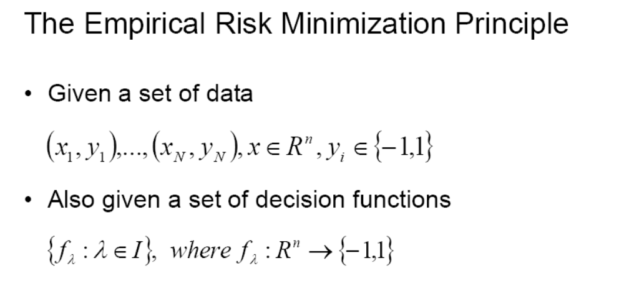
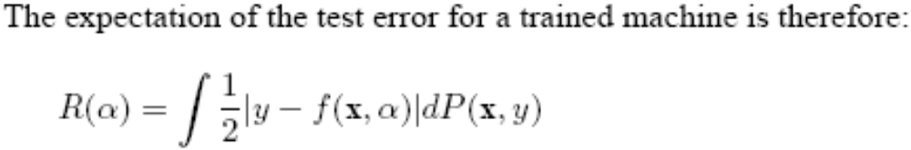
2. 統計學習理論與VC維

Slide 6
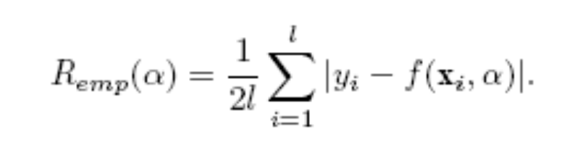
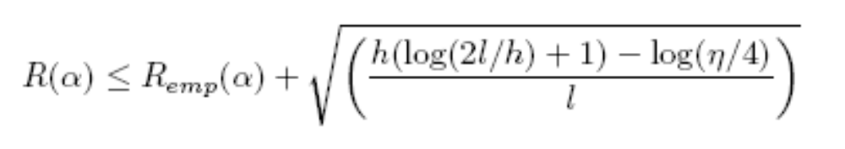
2. 統計學習理論與VC維
The“empirical risk” Remp(α) is defined to be just the measured mean error rate on the training set:
Now choose some η such that 0≤η < 1 . Then for losses taking these values, with probability 1–η, the following bound holds (Vapnik, 1995):

Slide 7
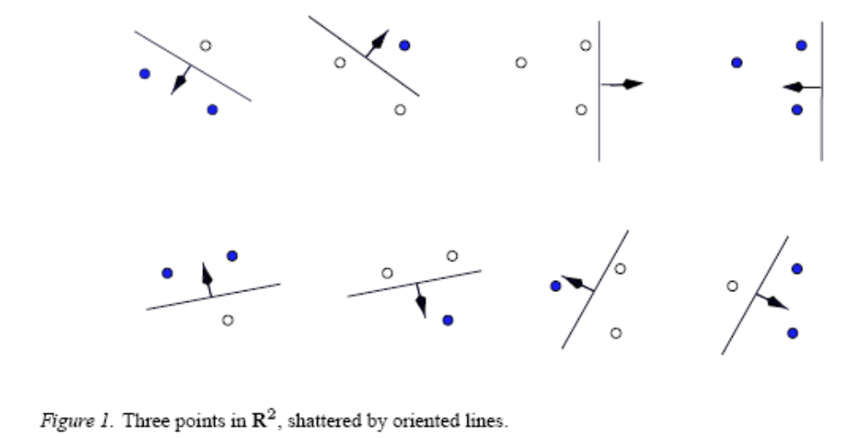
2. 統計學習理論與VC維
VC維(Vapnik Chervonenkis dimension)
  The VC dimension for the set of functions {f(α)} is defined as the maximum number of training points that can be shattered by {f(α)}.
VC維可作為函數族F複雜度的度量

Slide 8
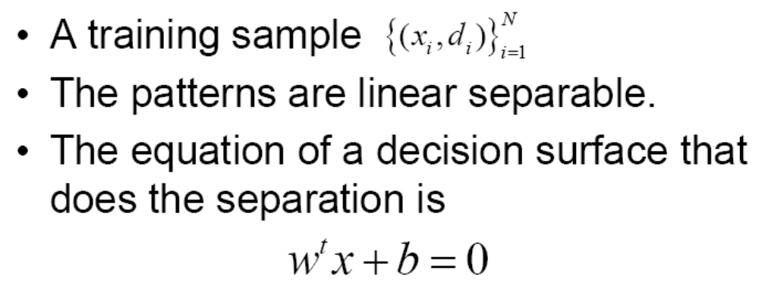


3. Linear Support Vector Machines
z
g(x)= w^{t}x + b = 0

Slide 9
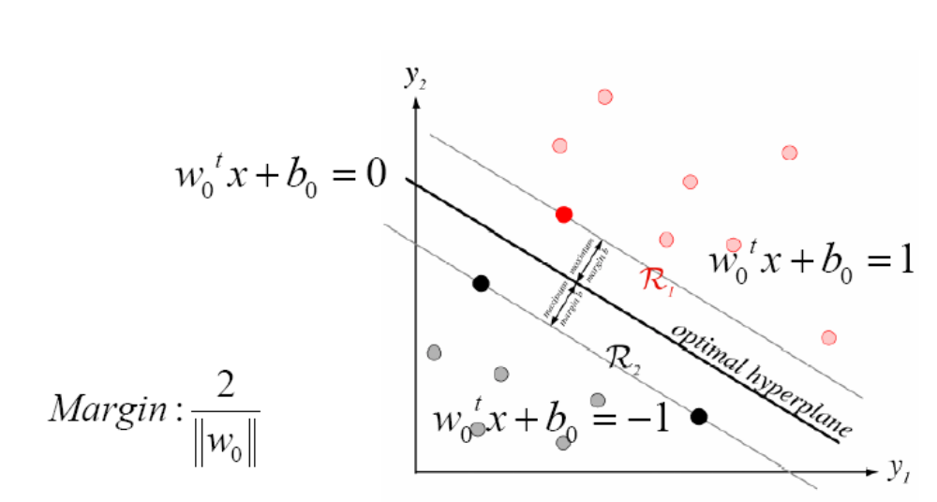
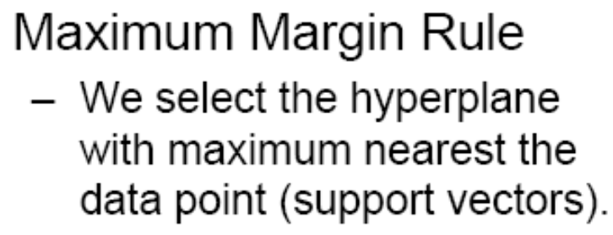
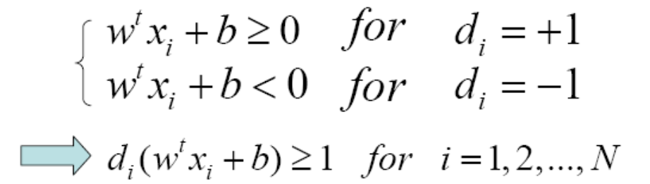
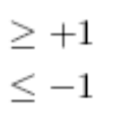
3. Linear Support Vector Machines

Slide 10
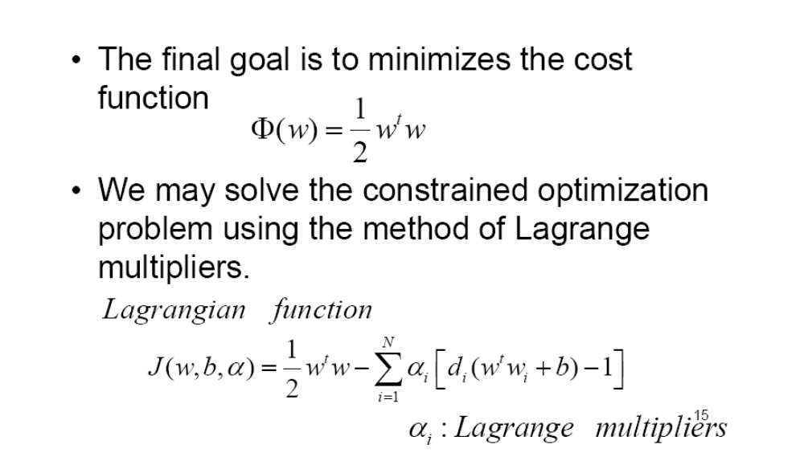
3. Linear Support Vector Machines

Slide 11
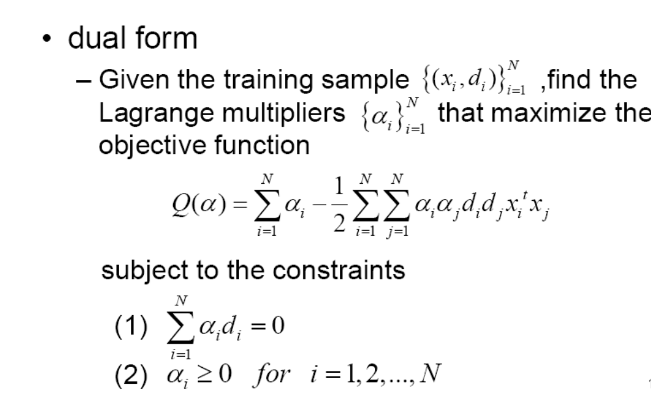
3. Linear Support Vector Machines

Slide 12
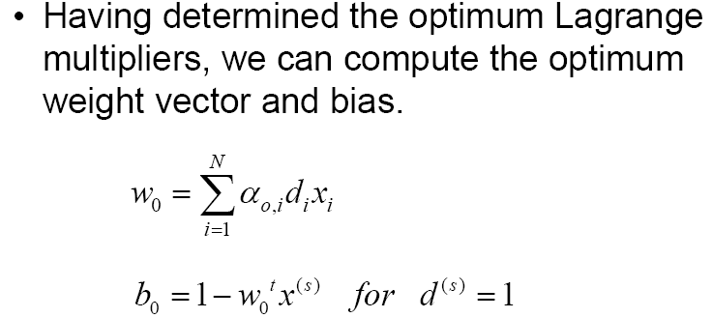
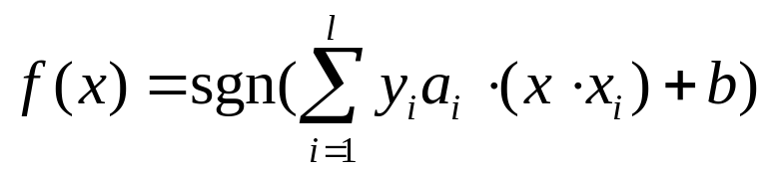
3. Linear Support Vector Machines
最後可以得到一個處理分類問題的函數：

Slide 13
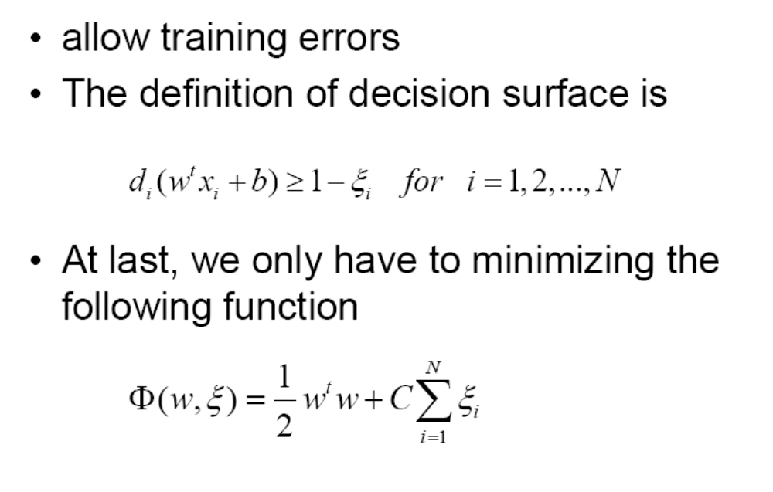
3. Linear Support Vector Machines

Slide 14
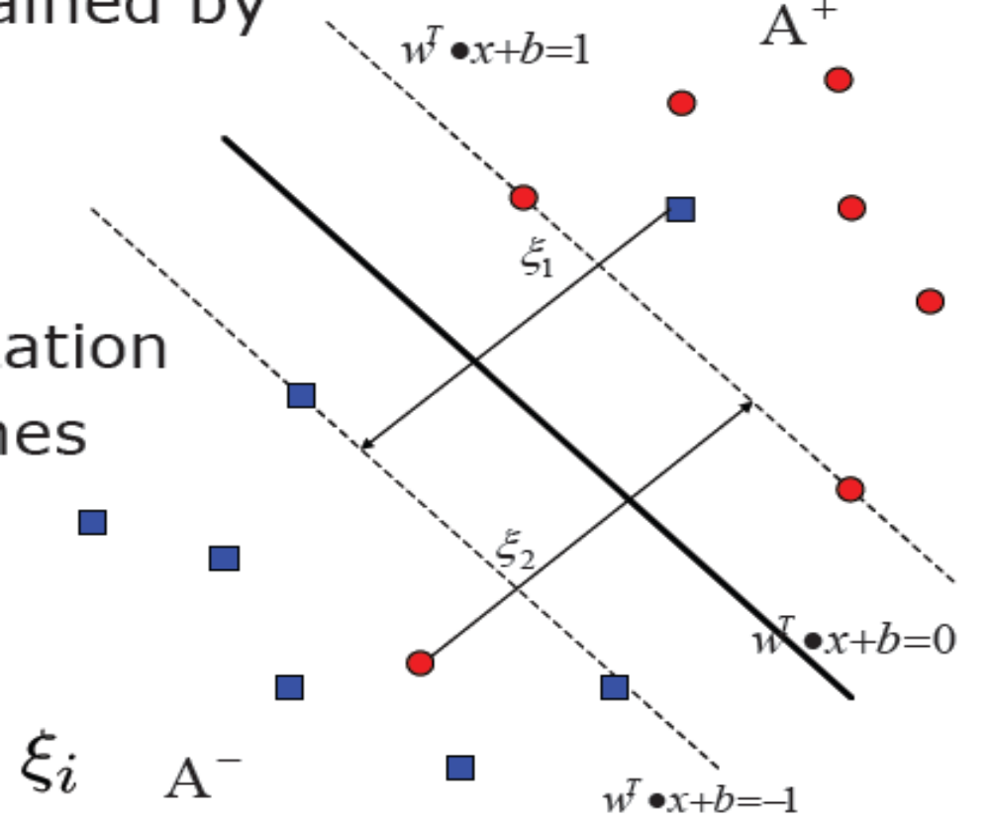
3. Linear Support Vector Machines

Slide 15
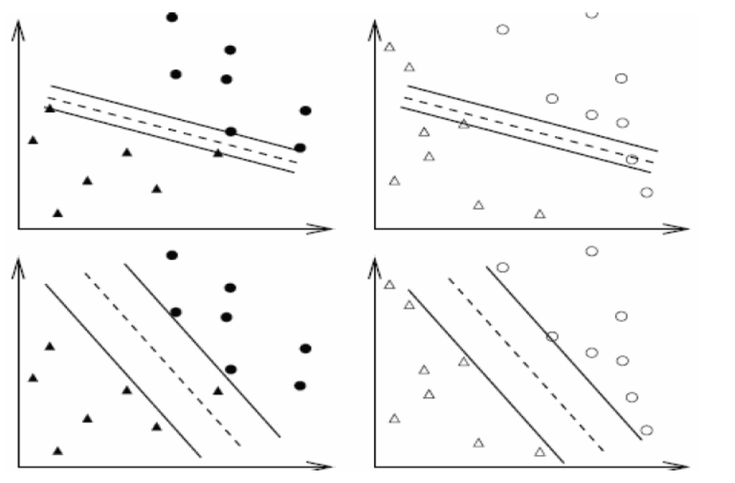
3. Linear Support Vector Machines

Slide 16
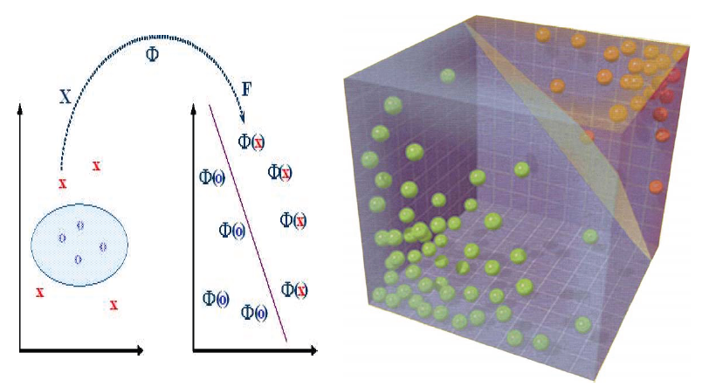
4. Nonlinear Support Vector Machines

Slide 17
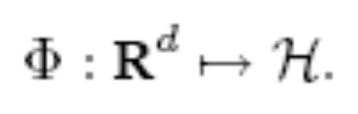


4. Nonlinear Support Vector Machines
Suppose we first mapped the data to some other Euclidean space H, using a mapping which we will call :
Then of course the training algorithm would only depend on the data through dot products in H, i.e. on functions of the form
Now if there were a “kernel function” K such that
, we would only need to use K in the training algorithm.

Slide 18
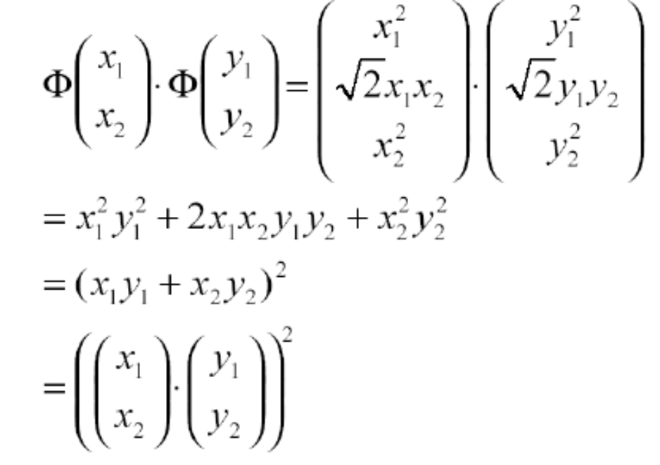
4. Nonlinear Support Vector Machines
通過

Slide 19




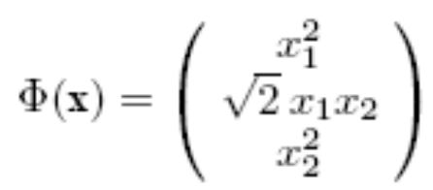
4. Nonlinear Support Vector Machines
Suppose that your data are vectors in R², and you choose Then it’s easy to find a space H, and mapping from R² to H, such that
EX1:H=R³ EX2:H=R⁴

Slide 20

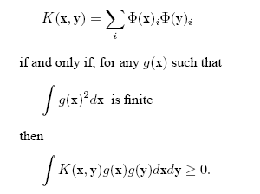
4. Nonlinear Support Vector Machines
For which kernels does there exist a pair , with the properties described above,and for which does there not? The answer is given by Mercer’s condition

Slide 21
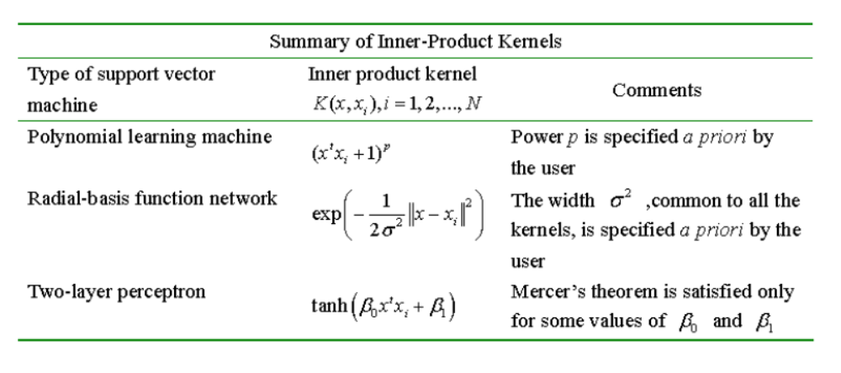
5. How to build a SVM for pattern recognition

